Slide 1

Algorithms for Visualizing Large Networks
-Yifan Hu
(AT&T Labs Research)
Presented by:
Shreyas Prabhakar

Slide 2

Overview
Introduction
Spring-Electrical Model
Fast Force Approximation
Multilevel Approach
Stress and Strain Model
Stress Model
Strain Model
High-Dimensional Embedding
Hall’s Algorithm
Conclusion
Notes:
2. 3 Open Problem: More Robust Coarsening Scheme

Slide 3
Introduction
Graphs
Used to encapsulate relationship between objects
Drawing should be aesthetic
Minimal edge crossing
Vertices evenly distributed in space
Connected vertices close to each other
Symmetry preserved
Notes:
2. No strict criteria

Slide 4
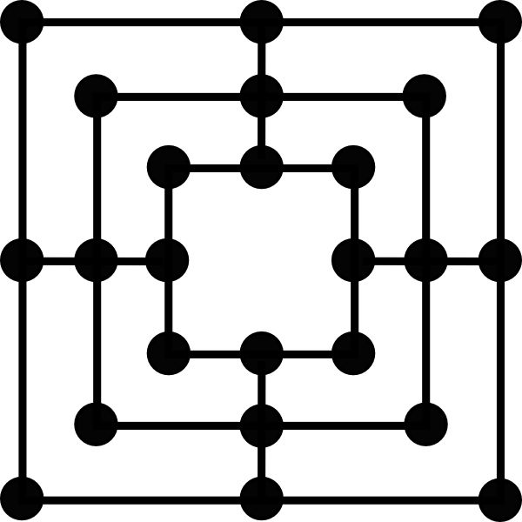
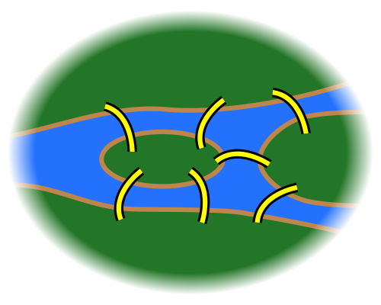
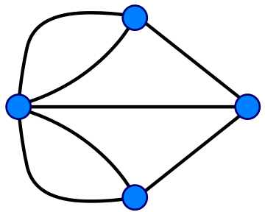
Early Examples and History
Mill Board Games in The Book of Games
Family tree and trees of virtues and vices
Seven Bridges of Königsberg
C
A
B
D
Notes:
Under direction of Alfonso X(1221-1284),King of Castile(Spain)
1735 – Euler – Problem – Find walk through city of Konigsberg. 2 islands A,D connected to mainland C,B. Walk must cross each bridge once and only once. Proved walk is impossible.
Euler paper – Foundations of Graph Theory!

Slide 5
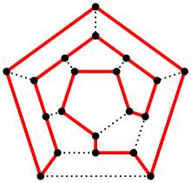
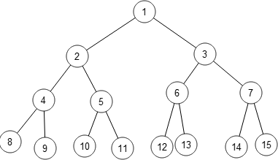
History
Iconsian Game – William Hamilton
Arthur Cayley – Concept of Tree
Sylvester – Concept of Graph
Sugiyama et al. – Method for hierarchical drawing of directed graphs
Eades – Force directed algorithm
Kamada and Kawai – Spring embedding algorithm

Slide 6
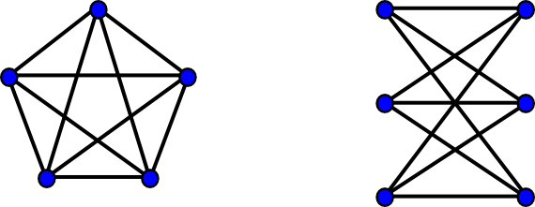
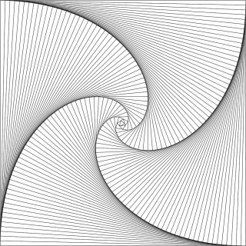
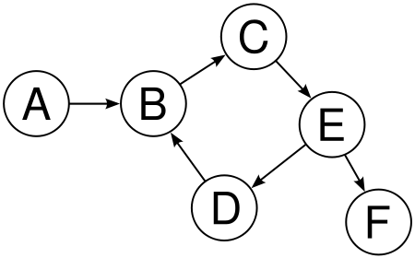
Styles of Graph Drawings
Planar Graphs
General Graphs
Straight Line Drawing
Orthogonal Drawing
Directed Graphs
Hierarchical Drawing

Slide 7
Visualizing Large Graphs
The term large is relative to the computing power and memory availability
Graphs of more than few thousand vertices
Examples – Internet Mapping, Social Networks, Biological Pathways
Unique Issues –
Complexity of the algorithm
Ability of algorithm in escaping from local minimum and achieving globally optimal drawing is vital
Notes:
Limit our attention – straight edge drawing of undirected graph

Slide 8
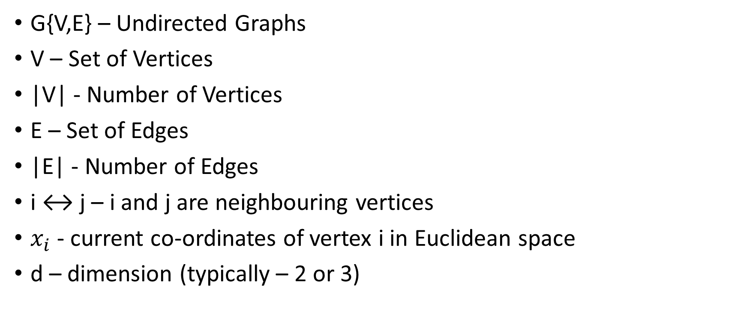
Notations
G{V,E} – Undirected Graphs
V – Set of Vertices
|V| - Number of Vertices
E – Set of Edges
|E| - Number of Edges
i ↔ j – i and j are neighbouring vertices
$x_{i}$- current co-ordinates of vertex i in Euclidean space
d – dimension (typically – 2 or 3)
Notes:
AIM – find xi for all i ∈ V
One way to solve the problem – find minimal energy configuration of the physical system

Slide 9
SPRING-ELECTRIC MODEL
Notes:
Represents graph drawing problem by a system of electrically charged vertices attracted to each other by springs. Vertices also repel each other by electrical forces

Slide 10
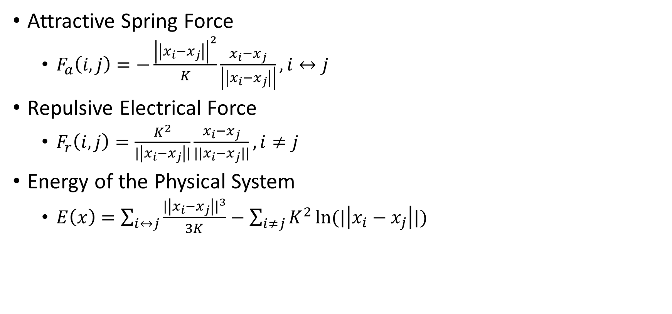
Spring-Electrical Model
Attractive Spring Force
$F_{a}\left(i,j\right)=−\frac{{\left|\left|x_{i}−x_{j}\right|\right|}^{2}}{K}\frac{x_{i}−x_{j}}{\left|\left|x_{i}−x_{j}\right|\right|},i↔j$
Repulsive Electrical Force
$F_{r}\left(i,j\right)=\frac{K^{2}}{|\left|x_{i}−x_{j}\right||}\frac{x_{i}−x_{j}}{{||x}_{i}−x_{j}||},i≠j$
Energy of the Physical System
$E\left(x\right)=\sum_{i↔j}{\frac{{|\left|x_{i}−x_{j}\right||}^{3}}{3K}−\sum_{i≠j}{K^{2}\ln{(|\left|x_{i}−x_{j}\right||)}}}$
Notes:
Fa exerted on i form its neighbour j proportional to square of distance between i and j
Fr exerted on i form any j is inversely proportional to distance between i and j
K = parameter related to nominal edge length of the final layout

Slide 11
Force-Directed Algorithm
ForceDirectedAlgorithm(G, x, tol, K) {
converged = FALSE;
step = initial step length;
while (converged equals FALSE) {
x0 = x;
for i ∈ V {
f = 0;
for (j ↔ i) f := f + Fa(i, j);
for (j 6= i, j ∈ V ) f := f + Fr(i, j);
xi := xi + step ∗ (f/||f||);
}
step := update steplength(step, x, x0);
if (||x − x0|| < tol ∗ K) converged = TRUE;
}
return x;
}
Starts with random layout
Calculate combined attractive and repulsive forces on each vertex
Move the vertices along the direction of force for a certain step length
Decrease step length for each iteration
Repeat until the layout stabilizes
Notes:
Force–directed algorithm – Appropriate when we talk about – “procedure that involves calculating forces exerted on vertices, moving them along the direction of forces, and repeating until the system comes to an equilibrium state.”
G- input graph, x – initial positions, tol – tolerance, K – nominal edge length

Slide 12
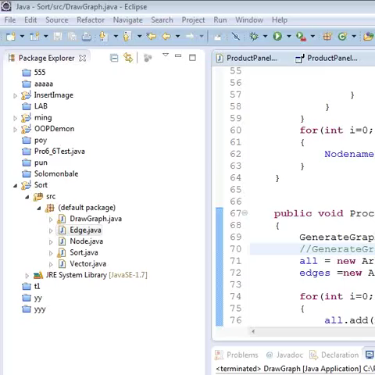
Force Directed algorithm
https://www.youtube.com/watch?v=VxiKoT_I_P4

Slide 13
Spring-Electrical Model
Fast Force Approximation
Multilevel Approach
Notes:
For large graphs – not sufficient to overcome many local minima that often exist in space of all possible layouts.
Multilevel approach
Nested Space portioning data structure
Force-directed algo – 2 loops. Outer –over each vertex. 2 inner loops.
2nd inner loop – all-to-all repulsive forces.
Overall complexity – O(|V|^2)

Slide 14
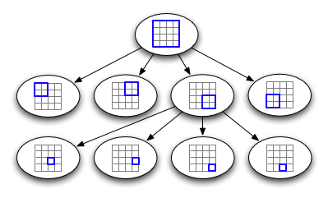
Fast Force Approximation
Repulsive force calculation resembles n-body calculation in physics
Approximate in O(n logn) time with good accuracy
Treat far away vertices as Supernodes, using suitable data structure
Quadtree or Octree
Notes:
Quadtree-
Form a square that encloses all vertices – level 0
Subdivide into 4 squares – level 1
Continue
Until it contains no more than 1 square

Slide 15
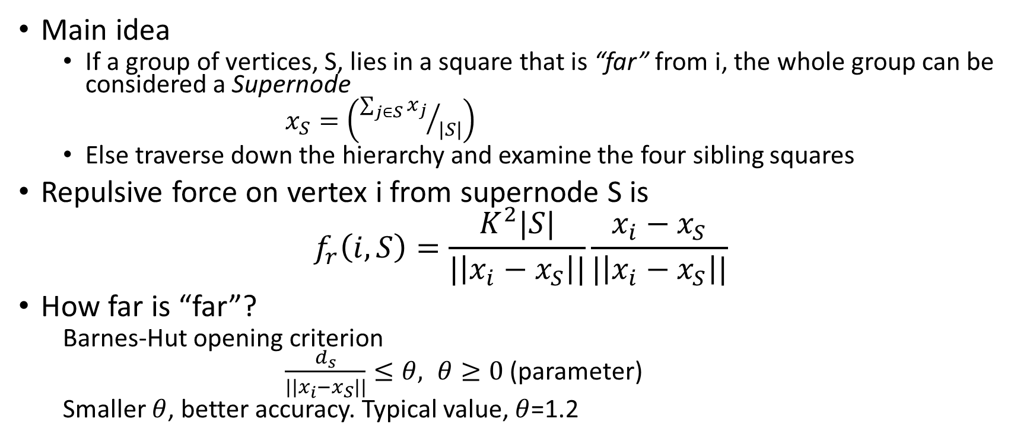
Fast Force Approximation
Main idea
If a group of vertices, S, lies in a square that is “far” from i, the whole group can be considered a Supernode
$x_{S}=\left({\sum_{j∈S}{x_{j}}}/{|S|}\right)$
Else traverse down the hierarchy and examine the four sibling squares
Repulsive force on vertex i from supernode S is
$$f_{r}\left(i,S\right)=\frac{K^{2}|S|}{|\left|x_{i}−x_{S}\right||}\frac{x_{i}−x_{S}}{|\left|x_{i}−x_{S}\right||}$$
How far is “far”?
Barnes-Hut opening criterion
$\frac{d_{s}}{|\left|x_{i}−x_{S}\right||}≤θ, θ≥0$(parameter)
Smaller $θ$, better accuracy. Typical value, $θ$=1.2
Notes:
3. S is far from i if width ds of square that contains supernode is small, compared with distance b/w S and i .
. Further improved – consider at supernode-supernode level instead of vertex-supernode level

Slide 16
Fast Force Approximation
Time complexity
Building quadtree – O(|V| log|V|)
Finding all supernodes – O(log|V|)
Overall complexity for each iteration – O(|V| log|V|)
Limitations
Repositions one vertex at a time, without “global view” of layout
Applying to random initial layout is unlikely to give optimal final optimal layout
Notes:
1. Further improved – consider at supernode-supernode level instead of vertex-supernode level
2. 2. Physical system of springs and electrical charges has many local minimum configurations, applying to forced directed algorithm directly to a random initial layout is unlikely to give an optimal layout

Slide 17
Spring-Electrical Model
Fast Force Approximation
Multilevel Approach

Slide 18
Multilevel Approach
A sequence of successively smaller graphs are generated, each captures the essential connectivity information of its parent.
Uses
Large-scale combinatorial optimization problems
Graph partitioning
Matrix ordering
Traveling salesman problem
Meta-heuristic tool
Graph drawing

Slide 19
Distinctive Stages of Multilevel Approach
Graph coarsening and initial layout
Coarsest graph layout
The prolongation and refinement step

Slide 20
Multilevel Approach
Graph coarsening and initial layout
Maximal Independent Edge Set (MIES)
Maximal Independent Vertex Set (MIVS)
Coarsest graph layout
The prolongation and refinement step
Notes:
Based on Edge collapsing (EC)
Maximal set of edges
With no edges incident on the same vertex
Each edge and its corresponding pair of vertices – coalesced into new vertex

Slide 21
Multilevel Approach
Graph coarsening and initial layout
Maximal Independent Edge Set (MIES)
Maximal Independent Vertex Set (MIVS)
Coarsest graph layout
The prolongation and refinement step
Notes:
Maximal set of vertices
No 2 vertices in the set are connected by an edge in the graph
Edges of coarser graph – formed through linking 2 vertices in minimal indendent vertex set by an edge – if their distance aprat is no greater than 3

Slide 22
Multilevel Approach
Graph coarsening and initial layout
Coarsest graph layout
Carried out at the end of recursive coarsening process.
Performed repeatedly until graph is small
Layout the graph
The prolongation and refinement step
Notes:
3. with suitable algorithm (Eg. Force Directed Algorithm)
Because the graph at coarsest level is very small – likely that it can be laid out optimally

Slide 23
Multilevel Approach
Graph coarsening and initial layout
Coarsest graph layout
The prolongation and refinement step
The layout on the coarser graph are recursively interpolated to the finer graphs
Notes:
, with further refinement at each level

Slide 24
Spring-Electrical Model
Drawings are good for both mesh-like graph and sparser graph
Suffer slightly from “warping effect”
Notes:
Mesh-graph : vertices are closer together near the boundary, compared to interior of the mesh

Slide 25
Spring-Electrical Model
Advantages
Scalable
It can layout graphs of millions if nodes in minutes
Limitations
Does not cope well when edges have predefined lengths
Notes:
2.1 Overcome limitation: Possible to assign weaker attractive force and stronger repulsive force for longer edges. This treatment is not as principled and direct as stress model

Slide 26
STRESS and STRAIN MODELS

Slide 27
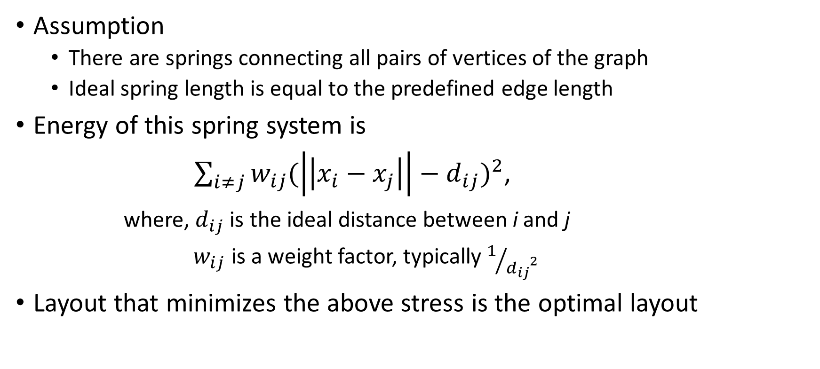
Stress Model
Assumption
There are springs connecting all pairs of vertices of the graph
Ideal spring length is equal to the predefined edge length
Energy of this spring system is
$\sum_{i≠j}{w_{ij}{(\left|\left|x_{i}−x_{j}\right|\right|−d_{ij})}^{2}}$,
where, $d_{ij}$ is the ideal distance between i and j
$w_{ij}$ is a weight factor, typically $1/{{d_{ij}}^{2}}$
Layout that minimizes the above stress is the optimal layout

Slide 28
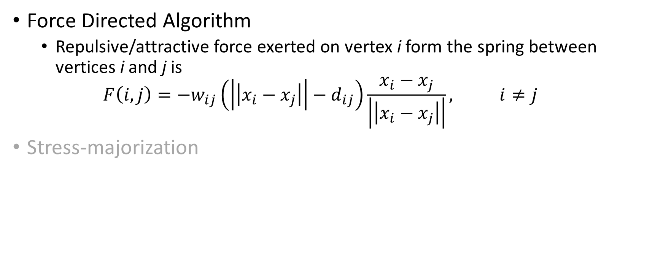
Ways to minimize Energy
Force Directed Algorithm
Repulsive/attractive force exerted on vertex i form the spring between vertices i and j is
$$F\left(i,j\right)=−w_{ij}\left(\left|\left|x_{i}−x_{j}\right|\right|−d_{ij}\right)\frac{x_{i}−x_{j}}{\left|\left|x_{i}−x_{j}\right|\right|}, i≠j$$
Stress-majorization

Slide 29
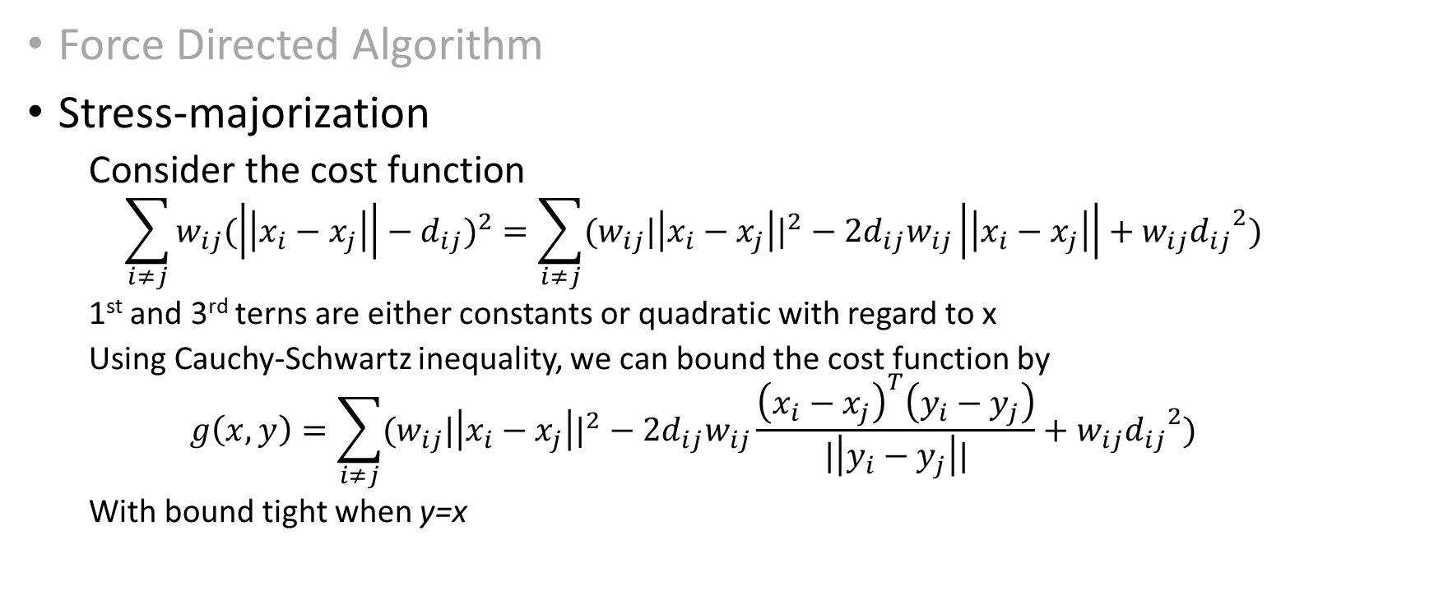
Ways to minimize Energy
Force Directed Algorithm
Stress-majorization
Consider the cost function
$$\sum_{i≠j}{w_{ij}{(\left|\left|x_{i}−x_{j}\right|\right|−d_{ij})}^{2}}=\sum_{i≠j}{{(w}_{ij}{|\left|x_{i}−x_{j}\right||}^{2}−2d_{ij}w_{ij}\left|\left|x_{i}−x_{j}\right|\right|+{w_{ij}d_{ij}}^{2})}$$
1st and 3rd terns are either constants or quadratic with regard to x
Using Cauchy-Schwartz inequality, we can bound the cost function by
$$g\left(x,y\right)=\sum_{i≠j}{{(w}_{ij}{|\left|x_{i}−x_{j}\right||}^{2}−2d_{ij}w_{ij}\frac{{\left(x_{i}−x_{j}\right)}^{T}\left(y_{i}−y_{j}\right)}{|\left|y_{i}−y_{j}\right||}+{w_{ij}d_{ij}}^{2})}$$
With bound tight when y=x

Slide 30
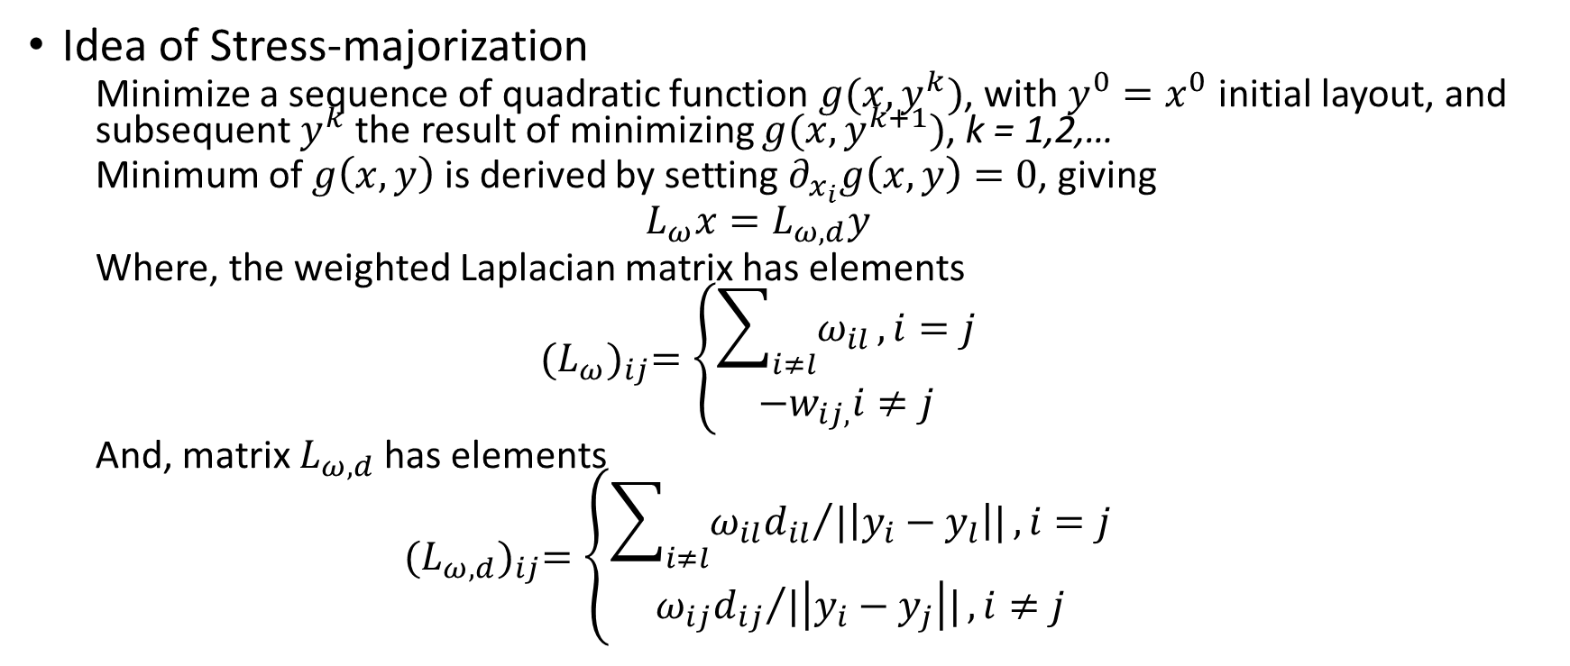
Stress Majorization
Idea of Stress-majorization
Minimize a sequence of quadratic function $g(x,y^{k})$, with $y^{0}=x^{0}$ initial layout, and subsequent $y^{k}$ the result of minimizing $g(x,y^{k+1})$, k = 1,2,…
Minimum of $g\left(x,y\right)$ is derived by setting $∂_{x_{i}}g\left(x,y\right)=0$, giving
$$L_{ω}x=L_{ω,d}y$$
Where, the weighted Laplacian matrix has elements
$${(L_{ω})}_{ij}=\left\{\begin{aligned}\sum_{i≠l}{ω_{il}},i=j \\ −w_{ij,}i≠j\end{aligned}\right.$$
And, matrix $L_{ω,d}$ has elements
$${(L_{ω,d})}_{ij}=\left\{\begin{aligned}\sum_{i≠l}{{ω_{il}d_{il}}/{|\left|y_{i}−y_{l}\right||}},i=j \\ {ω_{ij}d_{ij}}/{|\left|y_{i}−y_{j}\right||},i≠j\end{aligned}\right.$$

Slide 31
Stress Model
Summary
Process of finding minima becomes that of solving a series of linear systems, with x served as y in the next iteration
The process is quiet robust
For large graphs, it still benefits from a good initial layout
Performed well on both mesh and sparse graphs

Slide 32
Stress and Strain Model
Stress Model
Strain Model

Slide 33
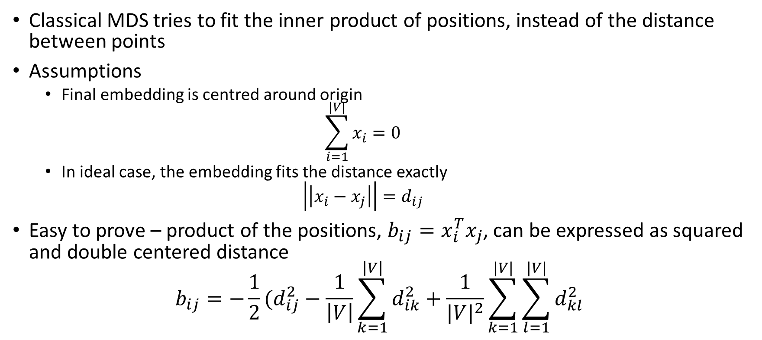
Strain Model (Classical MDS)
Classical MDS tries to fit the inner product of positions, instead of the distance between points
Assumptions
Final embedding is centred around origin
$$\sum_{i=1}^{|V|}{x_{i}=0}$$
In ideal case, the embedding fits the distance exactly
$$\left|\left|x_{i}−x_{j}\right|\right|=d_{ij}$$
Easy to prove – product of the positions, $b_{ij}=x_{i}^{T}x_{j}$, can be expressed as squared and double centered distance
$$b_{ij}=−\frac{1}{2}(d_{ij}^{2}−\frac{1}{\left|V\right|}\sum_{k=1}^{\left|V\right|}{d_{ik}^{2}}+\frac{1}{{|V|}^{2}}\sum_{k=1}^{|V|}{\sum_{l=1}^{|V|}{d_{kl}^{2}}}$$
Notes:
Predates the stress model
MDS – Multidimensional Scaling
Bij – 2 norm
In real data – unlikely to find an embedding that fits the distances perfectly
Still expect bij to be good approximation of x(transpose)*x
“Double centering” is subtracting the row and column means of the matrix from its elements, adding the grand mean and multiplying by -1/2.

Slide 34
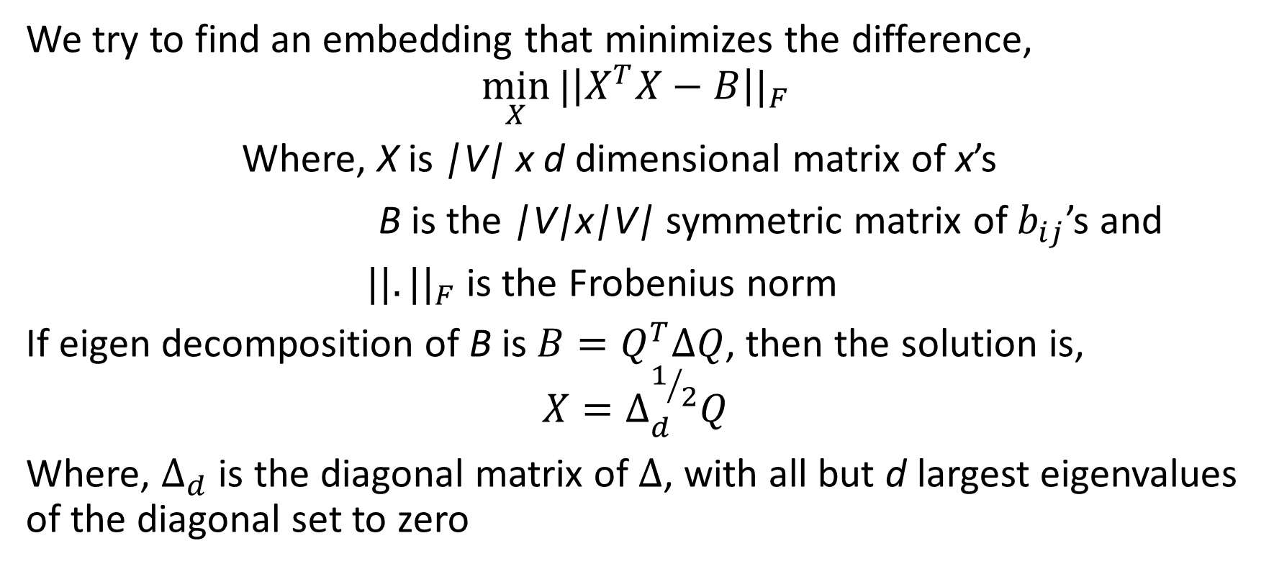
Strain Model (Classical MDS)
We try to find an embedding that minimizes the difference,
$$\min_{X}{{|\left|X^{T}X−B\right||}_{F}}$$
Where, X is |V| x d dimensional matrix of x’s
B is the |V|x|V| symmetric matrix of $b_{ij}$’s and
${||.||}_{F}$ is the Frobenius norm
If eigen decomposition of B is $B=Q^{T}∆Q$, then the solution is,
$$X=∆_{d}^{1/2}Q$$
Where, $∆_{d}$ is the diagonal matrix of $∆$, with all but d largest eigenvalues of the diagonal set to zero

Slide 35
Strain Model (Classical MDS)
Strain model does not fit distances directly.
Drawings are not satisfactory
Can be used as good starting point for stress model
Performed well on mesh-like structures, but not so well on spraser graph
Notes:
4. Vertices cling to each other, making details of graph unclear

Slide 36
HIGH DIMENSIONAL EMBEDDING

Slide 37
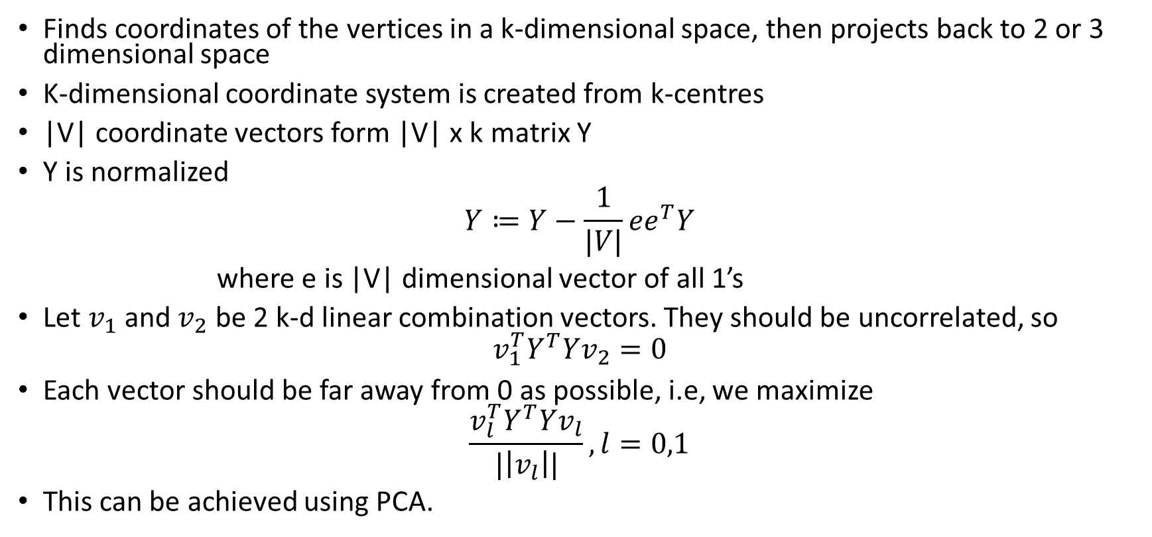
High-Dimensional Embedding(HDE)
Finds coordinates of the vertices in a k-dimensional space, then projects back to 2 or 3 dimensional space
K-dimensional coordinate system is created from k-centres
|V| coordinate vectors form |V| x k matrix Y
Y is normalized
$$Y≔Y−\frac{1}{|V|}ee^{T}Y$$
where e is |V| dimensional vector of all 1’s
Let $v_{1}$ and $v_{2}$ be 2 k-d linear combination vectors. They should be uncorrelated, so
$$v_{1}^{T}Y^{T}Yv_{2}=0$$
Each vector should be far away from 0 as possible, i.e, we maximize
$$\frac{v_{l}^{T}Y^{T}Yv_{l}}{|\left|v_{l}\right||},l=0,1$$
This can be achieved using PCA.
Notes:
5. pseudo-inverse

Slide 38
High-Dimensional Embedding(HDE)
Performs particularly badly on sparse graph

Slide 39
HALL’S ALGORITHM

Slide 40
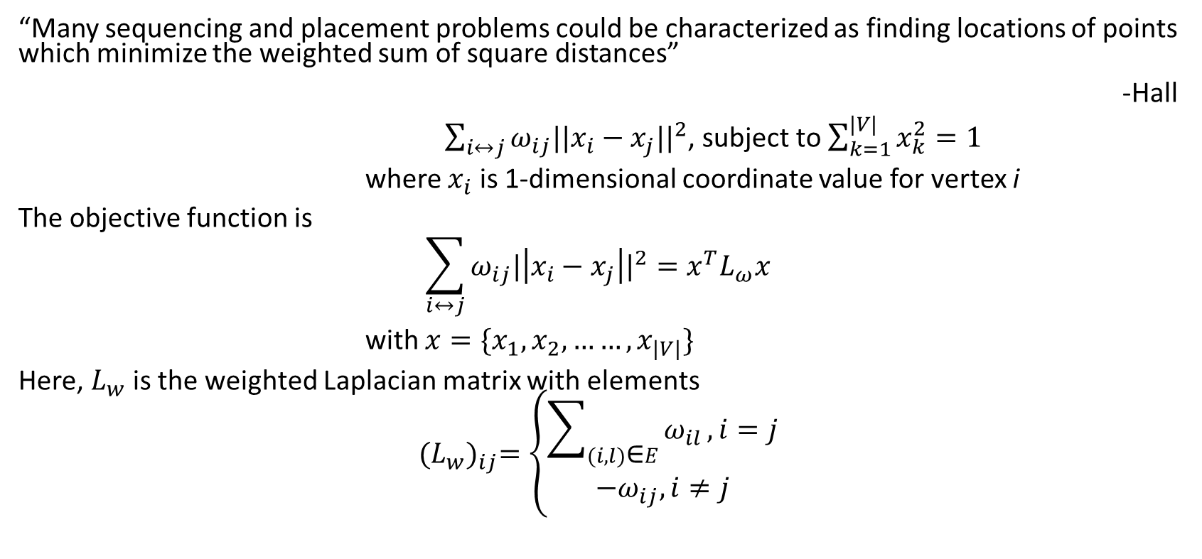
Hall’s Algorithm
“Many sequencing and placement problems could be characterized as finding locations of points which minimize the weighted sum of square distances”
-Hall
$\sum_{i↔j}{ω_{ij}||{x_{i}−x_{j}||}^{2}}$, subject to $\sum_{k=1}^{|V|}{x_{k}^{2}=1}$
where $x_{i}$ is 1-dimensional coordinate value for vertex i
The objective function is
$$\sum_{i↔j}{ω_{ij}{|\left|x_{i}−x_{j}\right||}^{2}=x^{T}L_{ω}x}$$
with $x=\{x_{1},x_{2},……,x_{|V|}\}$
Here, $L_{w}$ is the weighted Laplacian matrix with elements
$${(L_{w})}_{ij}=\left\{\begin{aligned}\sum_{(i,l)\text{∈}E}{ω_{il}},i=j \\ −ω_{ij},i≠j\end{aligned}\right.$$
Notes:
Objective function Lw norm

Slide 41
Hall’s Algorithm
For connected graph
Laplacian is positive semi-definite with one eigen value 0 corresponding to trivial eigen vector of all 1’s
For 2 dimensional layout, take 2 eigen vectors corresponding to the 2 smallest positive eigen values
Performed reasonably well on mesh-like graph
Almost useless on sparser graph

Slide 42
Conclusion
Challenges
Need for robust coarsening scheme
Laying out and visualizing a dynamically changing graph
Complex real world graphs of a “small-world” nature

Slide 43
THANK YOU

